Slide 1
DATA 603:
Used Car Price Analysis
Debanjan Chowdhury
Jin Hui Xu
Sooyeon Choi

Slide 2
Introduction
Tools used:
Dataset - Kaggle ( https://www.kaggle.com/ananaymital/us-used-cars-dataset )
Continent 3 million real world used car details, 66 columns
Obtained by running a self made crawler on Cargurus inventory in September 2020.
We decided to use 1/10 of the entire dataset, which is around 1 Gigabyte.
Python Libraries - pyspark.sql, matplotlib, seaborn, pyspark.ml, pandas, numpy, geopandas, shapely
DataBricks

Slide 3
Research question:
Used car price analysis
Goal: offering buyers car price estimates and suggestions.
Which factor has the highest impact on the price?
Which machine learning algorithm works best?

Slide 4
Import data/libraries
01
Data cleaning
02
Data exploration analysis
03
Process
Regression models
04
Classification models
(Nlp sentiment analysis)
05
Summary
Null values
Select Columns
count/avg price,
heatmap (correlation)
Linear Regression
Decision Tree
Random Forest
Logistic Regression
Naive Bayes
Random Forest

Slide 5
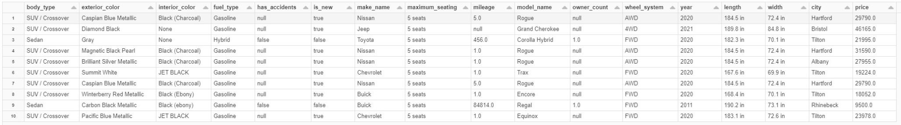
Selected columns (17/66)

Slide 6
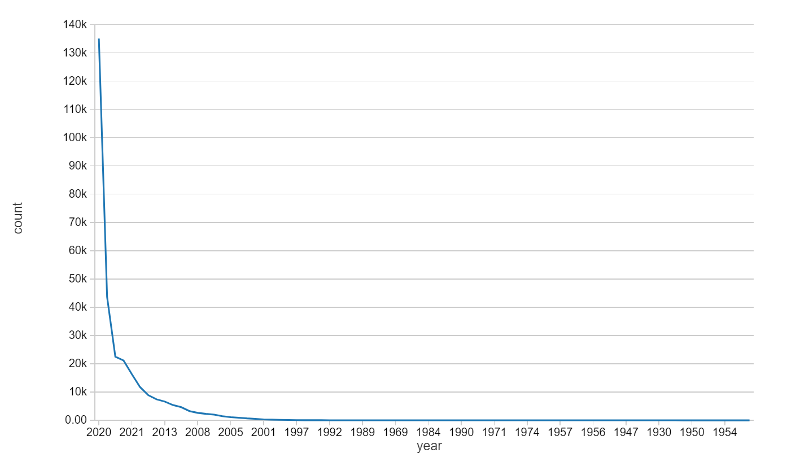
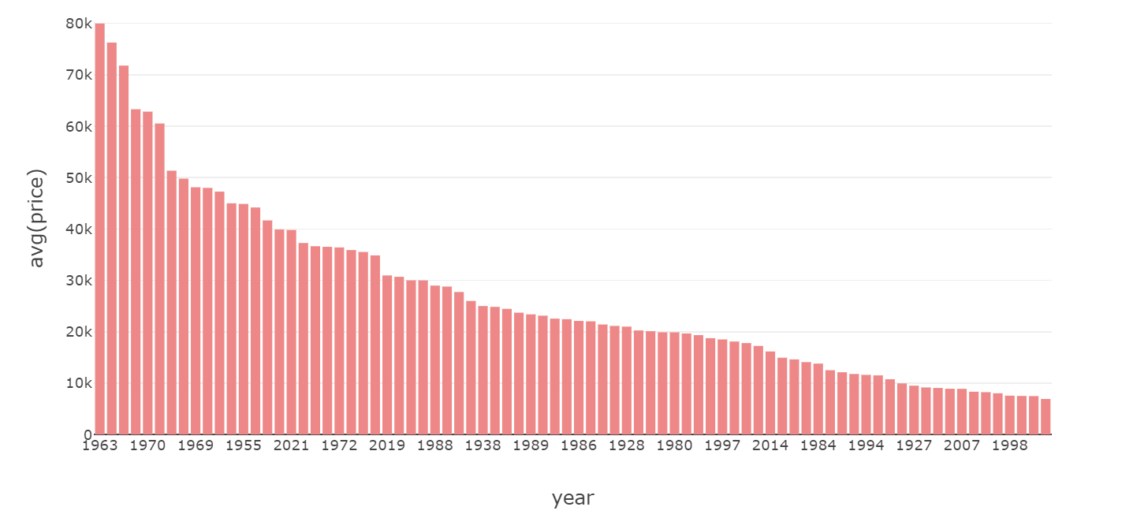
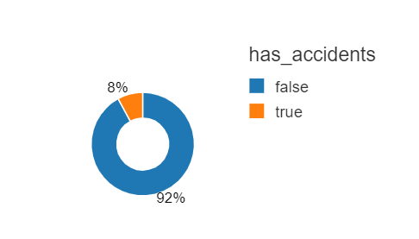
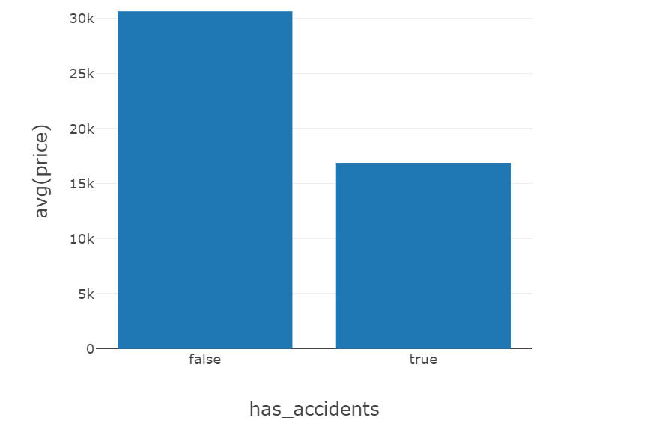
image
image
Data explore analysis
image
image
Most of the vehicles used in the data were from the year - 2008-2020
However, the highest average price was of all the vehicles from 1960-1970
description
description
Most of the folks in the data did not have an accident.
The average price for cars that did not have accident were higher as they have a higher occurrence.
description
description

Slide 7
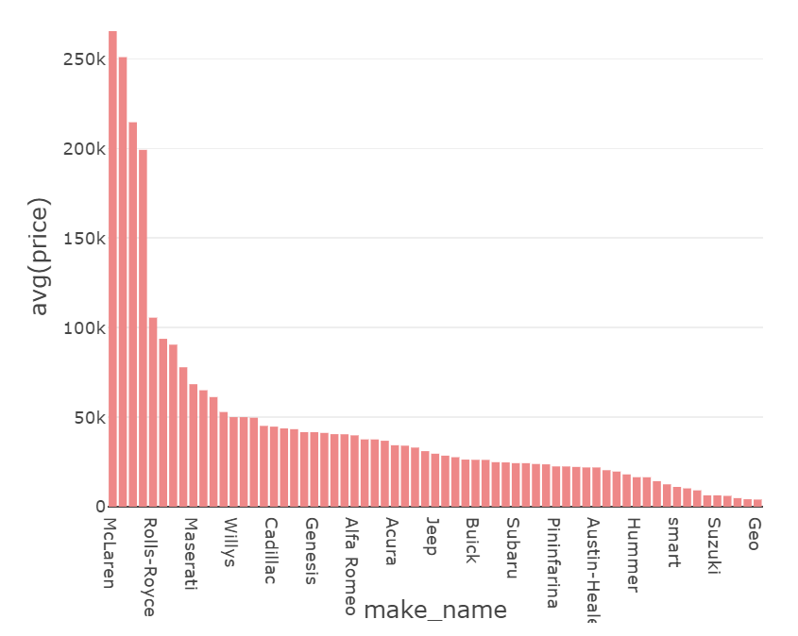
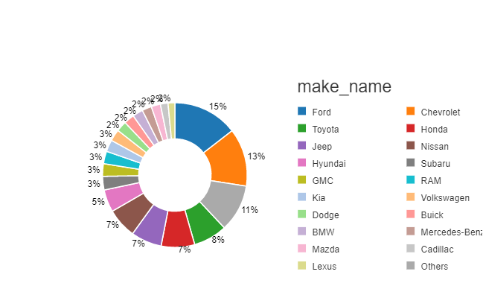
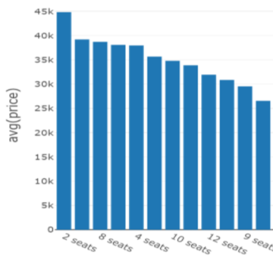
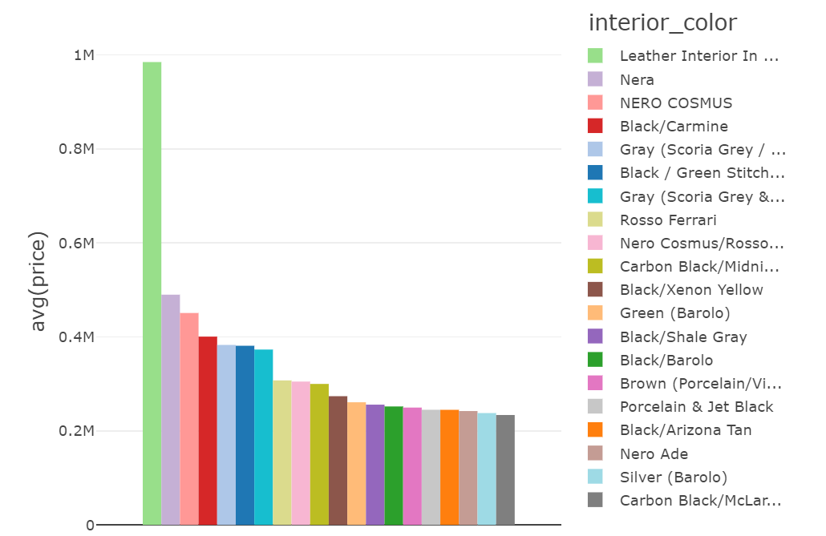

image
image
Data explore analysis
image
image
McLaren and Rolls Royce seem to have the highest average price and vehicles like Geo and Suzuki have the lowest average price.
Ford and Chevrolet have the highest existence and vehicles like GMC, Kia, Dodge have the lowest.
description
description
Leather interior has the highest average price and it could be an outlier as it seems to have a higher range than others.
Average price of 2-seater cars are the highest. 8 seaters are fairly high also they could be vans and SUVs.
description
description

Slide 8
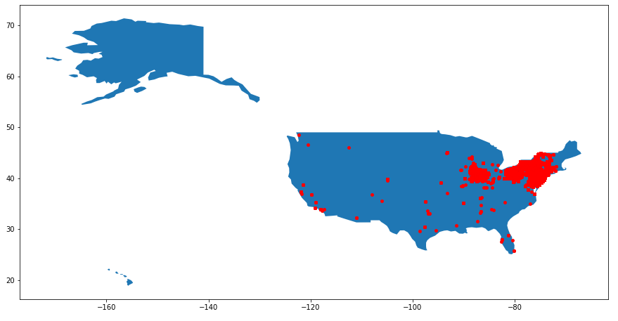
Spatial distribution
The Geo Distribution Map shows that the used cars for sale in this dataset are mostly located in the Northeastern United States.
Thus, the trained models might be biased and inaccurate for predicting the car price in other locations other than the Northeast.

Slide 9
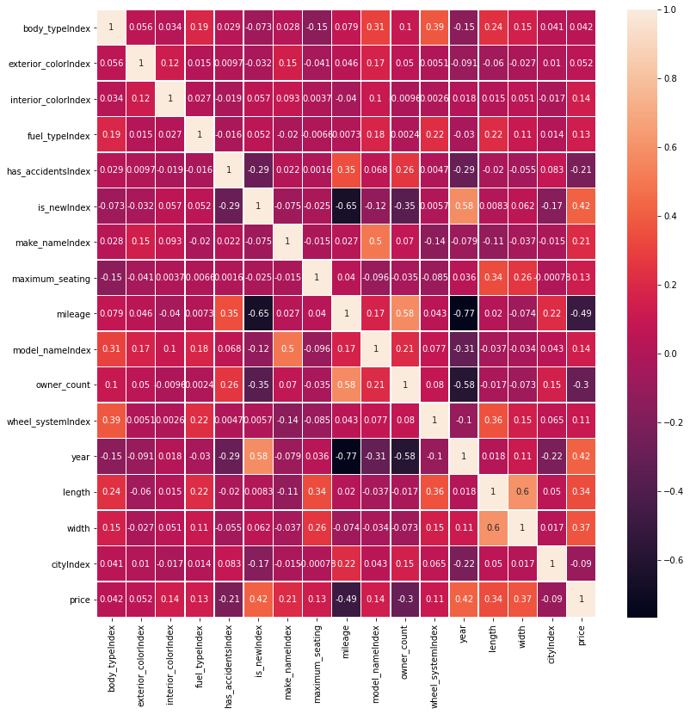
Heatmap (correlation)
"is new", "year", "length", and "width" features are having a pretty strong positive correlation with price.
"mileage" is having a strong negative correlation with price.

Slide 10
Regression models
Linear regression
Decision
tree
Random
forest
RMSE
6479.34
R2
0.85
RMSE
12326.24
R2
0.46
RMSE
7737.86
R2
0.79
Linear Regression has the best performance among the three regression models.

Slide 11
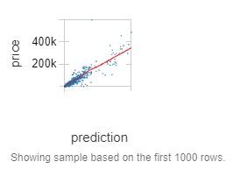
Linear Regression
After performing hyperparameter tuning with cross validation
Rmse 7296.59
R2 0.82
.

Slide 12

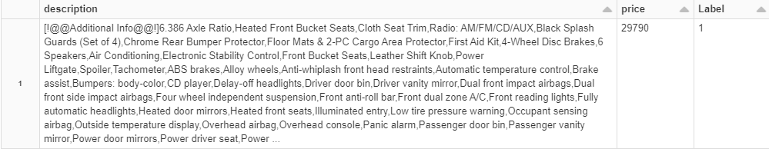
Classification models (nlp sentiment analysis)
Evaluate the textual feature on the data set:
Split the data into two categories based on the average price ($29461.54)
Label 0 : Above Average
Label 1 : Below Average

Slide 13
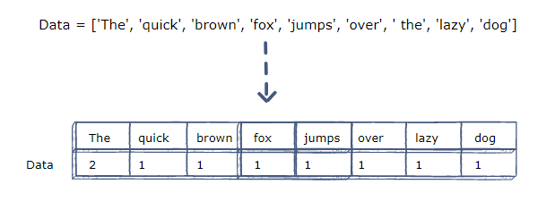
feature extraction
Tokenization
Remove stop words
Count Vectorization
TF-IDF (Term Frequency–Inverse Document Frequency) to down-weights features which appear frequently in the corpus.
Put everything in to a pipeline and transform the description dataset

Slide 14
Classification models
(nlp sentiment analysis)
Logistic
regression
Naive bayes
Random forest
ACCURACY
0.58313471991221
ACCURACY
0.8376742511273813
ACCURACY
0.7405908677834743
Naive Bayes has the highest accuracy score among the three classification models.
By performing hyperparameter tuning with cross validation, the Naive Bayes model accuracy is 0.8379828878105656

Slide 15
conclusion
From Regression Models, Linear Regression had the best performance and From Classification Models, Naive Bayes had the highest accuracy score.
The factors that influence the used car price the most were mileage of the car, whether the vehicle is new, the year made, and the length and width of the vehicle.

Slide 16
conclusion
Interesting Insights:
Model make or name did not have much impact on price.
Car description is essential to predict price range.
Limitations:
Biased Region
Whole dataset
Future Research:
Running the whole dataset to see if the results differ.
Finding dataset for different regions
Looking into difference between selling car to
used car shops vs trade-ins at dealerships

